Slide 1


Analysis Framework and Empirical Analysis Session No.: 5 Course Name: Design and analysis of algorithm Course Code: R1UC407B Instructor Name: Pradeep Chauhan Duration: 50 Min. Date of Conduction of Class:

Slide 2
Review of the key concepts: Analysis Framework

Slide 3
Importance of analysis, various metrices?

Slide 4
Learning Outcomes:Student will be able to
Analyse space complexity of an algorithm.
Analyse various algorithm design techniques.

Slide 5
Session Outline
1 Introduction
2 Concept and definition
3 Activity (scenario based)
4 Reflection learning activity
5 Conclusion
6 Feedback

Slide 6
5. Algorithm Design Techniques 5.1 Divide and Conquer Breaks problem into subproblems, solves them independently, and combines results. Example: Merge Sort, Quick Sort. 5.2 Greedy Algorithms Makes locally optimal choices at each step. Example: Dijkstra’s Algorithm, Kruskal’s Algorithm, Prim’s algorithm. 5.3 Dynamic Programming Solves problems by storing solutions to subproblems to avoid re computation. Example: Fibonacci Sequence, Knapsack Problem.

Slide 7
5.4 Backtracking Tries all possible solutions and backtracks when a solution is infeasible. Example: N-Queens Problem, Subset sum problem. 5.5 Branch and Bound An optimization technique that systematically explores solution space by bounding non-promising branches. Used in solving combinatorial optimization problems. Example: Traveling Salesman Problem, Knap Sack Problem.

Slide 8
Space Complexity :Space complexity refers to the amount of memory an algorithm requires relative to the input size (𝑛). It includes: Fixed part: Memory required for constants, variables, and function calls. Variable part: Memory needed for dynamic allocations such as arrays, recursion stack, etc. We use Big-O notation to express space complexity, which focuses on the dominant term and ignores constants. Exp1: int sum(int a, int b) { int result = a + b; return result; } ans: result=1,a=1,b=1 so O(1) space complexity

Slide 9
Exp2: void storeArray(int n) { int arr[n]; } ans: arr=n and n=1 so O(n) Exp3: void storeMatrix(int n) { int matrix[n][n]; } ans: n=1,matrix=n*n so O(n2). Exp4: int binarySearch(int arr[], int left, int right, int key) { if (left > right) return -1; int mid = left + (right - left) / 2; if (arr[mid] == key) return mid; else if (arr[mid] > key) return binarySearch(arr, left, mid - 1, key); else return binarySearch(arr, mid + 1, right, key);} ans: space complexity = O(1) and Auxiliary space complexity=O(log n)

Slide 10
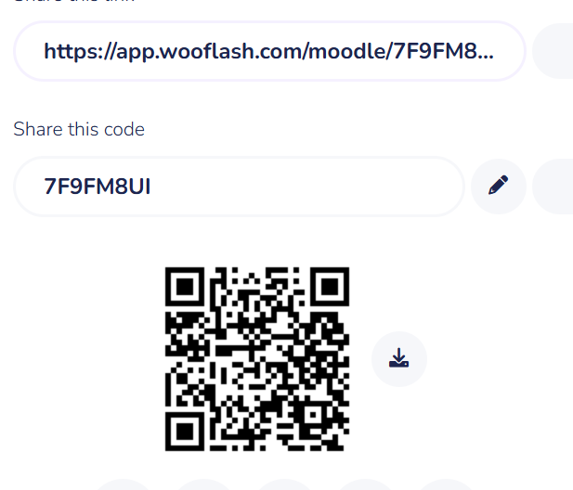
Activity-1: Think Pair Share (15 minutes)
Find space complexity of following codes:
sum(A,n) { int s=0; for(int i=0;i<n;i++) { s=s+A[i]; } return s; } | sum(A,B,n) { int C[ ][ ]; for(int i=0;i<n;i++) { for(int j=0;j<n;j++) { C[i][j]=A[i][j]+B[i][j]; } } return C; }

Slide 11
Reflection- a. A=address ,n=1, s=1,i=1 b. A,B,C=n*n , i=1 , j=1 , n=1So O(n2)

Slide 12
Activity-2: Individual(10 minutes)
MCQ based quiz on this session.

Slide 13
Conclusion: Now student can do
Analyse space complexity of an algorithm.
Analyse various algorithm design techniques.

Slide 14
Post session activities MCQ Based Quiz on LMS.

Slide 15
In the next session, analysis of non recursive algorithm will be discussed in detail.

Slide 16
Review and Reflection from students

